Slide 1
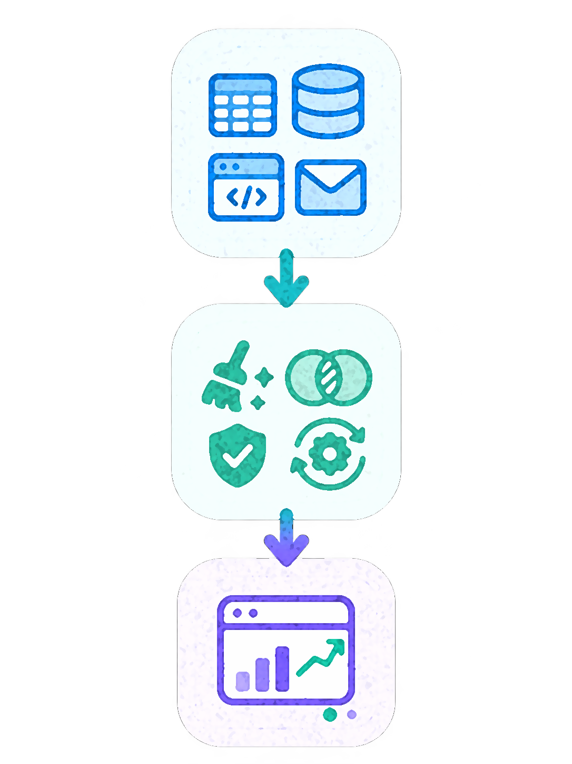
DATA ENGINEERING
& ANALYTICS
From raw records to confident business decisions
DAY 1 • CONCEPTS
Naman Sharma | K. R. Mangalam University
21 October 2026
Notes:
RUN OF SHOW — DAY 1
09:15–09:18 (3 minutes)
Session: WELCOME & ICEBREAKER
Slide: From raw data to decisions
FACILITATOR NOTES
Open with energy and ask students to notice one data-driven decision they made today. Explain this is not a coding exam.
CASE DISCLAIMER
ClinicPulse Hospital and any patient/appointment data in the deck are fictional and illustrative.
IMAGE PLACEHOLDER: A light-background data pipeline or hospital analytics illustration. Replace editable dashed box with your own relevant image or screenshot before presenting, or leave it as a visual prompt.

Slide 2











WELCOME & ICEBREAKER
Who am I?
Industry background
I am a Data Engineering, Analytics, and AI professional with 4 years of industry experience and the Founder of InnoSN Soft Tech, a technology-driven venture focused on innovative software, AI, and data solutions. Previously, I worked as a Business Technology Solutions Associate at ZS Associates, delivering enterprise-scale data engineering, business intelligence, and commercial analytics solutions for Fortune 500 clients across the US healthcare, life sciences, and pharmaceutical sectors. My expertise spans Data Engineering, Data Analytics, Business Intelligence, Generative AI, and Data Governance, with hands-on proficiency in SQL, Python, Databricks, Snowflake, Amazon Redshift, Tableau, and Microsoft Fabric. I have contributed to enterprise reporting and analytics solutions supporting 500+ business users across the United States. Beyond corporate consulting, I am passionate about technology innovation, entrepreneurship, and bridging the gap between academic knowledge and real-world industry applications by empowering aspiring engineers with practical, industry-relevant skills.
NAMAN SHARMA
Data Engineering & Analytics
K. R. MANGALAM UNIVERSITY • 21 OCT 2026
NAMAN SHARMA / 02
Notes:
RUN OF SHOW — DAY 1
09:18–09:23 (5 minutes)
Session: WELCOME & ICEBREAKER
Slide: Meet your industry guide
FACILITATOR NOTES
Brief introduction: former ZS Associates Business Technology Solutions Associate, June 2024–June 2026. Experience includes healthcare commercial analytics and incentive analytics; do not overstate credentials. Mention a preference for questions over perfect answers.
CASE DISCLAIMER
ClinicPulse Hospital and any patient/appointment data in the deck are fictional and illustrative.
IMAGE PLACEHOLDER: A professional photo of Naman Sharma. Replace editable dashed box with your own relevant image or screenshot before presenting, or leave it as a visual prompt.

Slide 3
WELCOME & ICEBREAKER
The promise for today
See the big picture
Try the building blocks
Think like three roles
Understand how data moves from raw records to business decisions.
Practice reasoning about data, joins, checks and KPIs.
Experience the Data Engineer, Data Analyst and Business Analyst perspectives.
K. R. MANGALAM UNIVERSITY • 21 OCT 2026
NAMAN SHARMA / 03
Notes:
RUN OF SHOW — DAY 1
09:23–09:28 (5 minutes)
Session: WELCOME & ICEBREAKER
Slide: The promise for today
FACILITATOR NOTES
Invite students to say their familiarity: beginner, some SQL, advanced. Make everyone comfortable, especially first-years.
CASE DISCLAIMER
ClinicPulse Hospital and any patient/appointment data in the deck are fictional and illustrative.

Slide 4
WELCOME & ICEBREAKER
You already work with data
EXAMPLES
Where did data influence your choices today?
A map route · an app recommendation · food ratings · a bank alert
K. R. MANGALAM UNIVERSITY • 21 OCT 2026
NAMAN SHARMA / 04
Notes:
RUN OF SHOW — DAY 1
09:28–09:35 (7 minutes)
Session: WELCOME & ICEBREAKER
Slide: You already work with data
FACILITATOR NOTES
Think-pair-share: 2 minutes solo, 2 pair, 3 student examples. Point out that data-driven products have pipelines behind them.
CASE DISCLAIMER
ClinicPulse Hospital and any patient/appointment data in the deck are fictional and illustrative.

Slide 5
WELCOME & ICEBREAKER
One hospital. Three complaints.
Our fictional case: ClinicPulse Hospital on a busy Monday morning
A patient
A doctor
Hospital manager
My appointment was cancelled.
Some hours are overloaded; others are quiet.
Show me what is happening—and why.
THE BRIEF
How can one messy dataset answer three different questions?
K. R. MANGALAM UNIVERSITY • 21 OCT 2026
NAMAN SHARMA / 05
Notes:
RUN OF SHOW — DAY 1
09:35–09:43 (8 minutes)
Session: WELCOME & ICEBREAKER
Slide: One hospital. Three complaints.
FACILITATOR NOTES
Introduce fictional ClinicPulse. These are deliberately synthetic learning scenarios. Ask who might own each concern. Avoid real patients or personally identifiable data.
CASE DISCLAIMER
ClinicPulse Hospital and any patient/appointment data in the deck are fictional and illustrative.

Slide 6
WELCOME & ICEBREAKER
What would you investigate?
TASK
Write three questions the hospital should ask.
Identify two datasets you would request.
Choose one number management should track.
K. R. MANGALAM UNIVERSITY • 21 OCT 2026
NAMAN SHARMA / 06
Notes:
RUN OF SHOW — DAY 1
09:43–09:53 (10 minutes)
Session: WELCOME & ICEBREAKER
Slide: Pair challenge: what would you investigate?
FACILITATOR NOTES
Let students design the investigation without giving answers. Ask clarifying follow-up questions and listen for appointment status, doctor, patient, date, revenue.
CASE DISCLAIMER
ClinicPulse Hospital and any patient/appointment data in the deck are fictional and illustrative.

Slide 7
WELCOME & ICEBREAKER
Our storyline for the day
Business question
Data engineering
Data analytics
Business action
What should improve?
Can we trust the records?
What patterns exist?
What should change?
REMEMBER
A working report is the end of a chain—not the beginning.
K. R. MANGALAM UNIVERSITY • 21 OCT 2026
NAMAN SHARMA / 07
Notes:
RUN OF SHOW — DAY 1
09:53–10:00 (7 minutes)
Session: WELCOME & ICEBREAKER
Slide: Our storyline for the day
FACILITATOR NOTES
Debrief the pair exercise. Draw the connections: requirements to records to analysis to action. This becomes the through-line for the next six hours.
CASE DISCLAIMER
ClinicPulse Hospital and any patient/appointment data in the deck are fictional and illustrative.

Slide 8
INDUSTRY ROLES & CASES
01
Three roles. One outcome.
The same business problem looks different to different teams.
K. R. MANGALAM UNIVERSITY • 21 OCT 2026
NAMAN SHARMA / 08
Notes:
RUN OF SHOW — DAY 1
10:00–10:05 (5 minutes)
Session: INDUSTRY ROLES & CASES
Slide: Three roles. One outcome.
FACILITATOR NOTES
Transition from the opening case. Show role boundaries overlap in smaller teams. These are examples, not rigid job descriptions.
CASE DISCLAIMER
ClinicPulse Hospital and any patient/appointment data in the deck are fictional and illustrative.

Slide 9
INDUSTRY ROLES & CASES
Who is responsible for what?
Data Engineer
Data Analyst
Business Analyst
Creates reliable pipelines and tables from messy source data.
Transforms trusted data into metrics, visuals and explanations.
Defines the business problem, requirements and success criteria.
K. R. MANGALAM UNIVERSITY • 21 OCT 2026
NAMAN SHARMA / 09
Notes:
RUN OF SHOW — DAY 1
10:05–10:10 (5 minutes)
Session: INDUSTRY ROLES & CASES
Slide: Who is responsible for what?
FACILITATOR NOTES
Ask students which role they are most curious about. Highlight collaboration and overlapping skills.
CASE DISCLAIMER
ClinicPulse Hospital and any patient/appointment data in the deck are fictional and illustrative.

Slide 10
INDUSTRY ROLES & CASES
What the data engineer asks
Can we trust the data?
Example deliverable
Are records complete, correct, joinable and updated when needed?
One validated appointments table refreshed on schedule.
THE POINT
Engineering success = usable, reproducible and reliable data.
K. R. MANGALAM UNIVERSITY • 21 OCT 2026
NAMAN SHARMA / 10
Notes:
RUN OF SHOW — DAY 1
10:10–10:15 (5 minutes)
Session: INDUSTRY ROLES & CASES
Slide: What the engineer asks
FACILITATOR NOTES
Avoid implying engineers only write code; explain ownership of quality and pipelines.
CASE DISCLAIMER
ClinicPulse Hospital and any patient/appointment data in the deck are fictional and illustrative.

Slide 11
INDUSTRY ROLES & CASES
What the data analyst asks
What is happening?
Example deliverable
Which doctors are overloaded? How often do cancellations occur?
A dashboard that explains patterns and offers recommendations.
THE POINT
Analytics success = decisions backed by correctly defined metrics.
K. R. MANGALAM UNIVERSITY • 21 OCT 2026
NAMAN SHARMA / 11
Notes:
RUN OF SHOW — DAY 1
10:15–10:20 (5 minutes)
Session: INDUSTRY ROLES & CASES
Slide: What the analyst asks
FACILITATOR NOTES
Ask: would a dashboard with incorrect counts be useful? Tie to data quality.
CASE DISCLAIMER
ClinicPulse Hospital and any patient/appointment data in the deck are fictional and illustrative.

Slide 12
INDUSTRY ROLES & CASES
What the business analyst asks
What decision is needed?
Example deliverable
Who needs the answer, by when, and what would “improvement” mean?
Prioritized requirements, a KPI definition and acceptance criteria.
THE POINT
Business analysis success = solving the right problem.
K. R. MANGALAM UNIVERSITY • 21 OCT 2026
NAMAN SHARMA / 12
Notes:
RUN OF SHOW — DAY 1
10:20–10:25 (5 minutes)
Session: INDUSTRY ROLES & CASES
Slide: What the business analyst asks
FACILITATOR NOTES
BA can refer to many roles; emphasize requirements and business process analysis, not just technology.
CASE DISCLAIMER
ClinicPulse Hospital and any patient/appointment data in the deck are fictional and illustrative.

Slide 13
INDUSTRY ROLES & CASES
Quick quiz: whose first move?
TASK
VOTE
Appointments contain duplicate rows.
Engineer? Analyst? BA?
Sometimes more than one role.
The dashboard shows an unexplained cancellation spike.
Two managers disagree on what “cancelled” means.
K. R. MANGALAM UNIVERSITY • 21 OCT 2026
NAMAN SHARMA / 13
Notes:
RUN OF SHOW — DAY 1
10:25–10:30 (5 minutes)
Session: INDUSTRY ROLES & CASES
Slide: Quick quiz: whose first move?
FACILITATOR NOTES
Poll students by raising hands. Intended responses: engineer; analyst working with engineer; BA facilitates shared metric definition. Many shared responsibilities.
CASE DISCLAIMER
ClinicPulse Hospital and any patient/appointment data in the deck are fictional and illustrative.

Slide 14
DATA LIFECYCLE
02
The journey of one record
From an appointment created at reception to a decision in a meeting.
K. R. MANGALAM UNIVERSITY • 21 OCT 2026
NAMAN SHARMA / 14
Notes:
RUN OF SHOW — DAY 1
10:30–10:36 (6 minutes)
Session: DATA LIFECYCLE
Slide: The journey of one record
FACILITATOR NOTES
Trace one appointment record through the system. Distinguish information flow from action taken on it.
CASE DISCLAIMER
ClinicPulse Hospital and any patient/appointment data in the deck are fictional and illustrative.

Slide 15
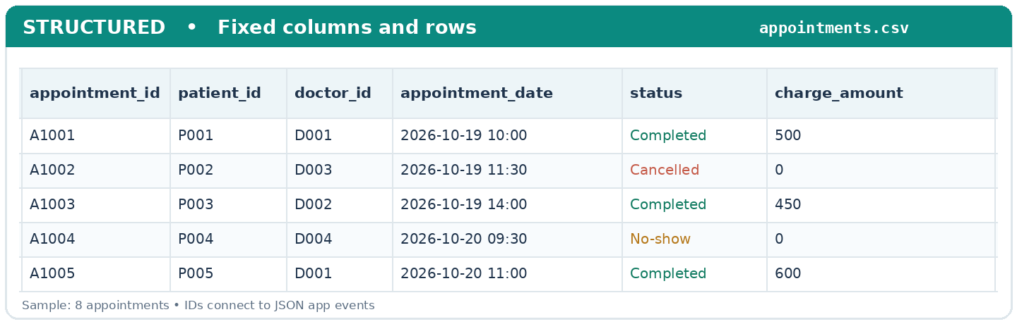
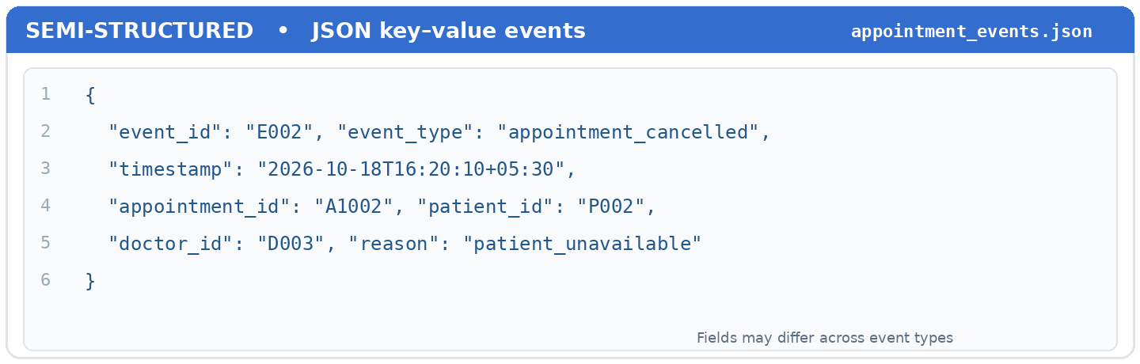
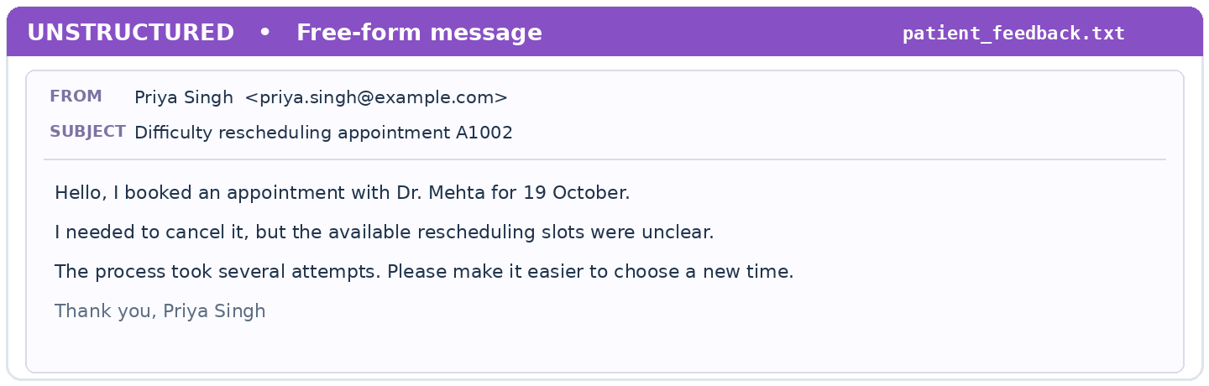
DATA LIFECYCLE
What does data look like?
Structured
Semi-structured
Unstructured
Rows and columns: patient_id, doctor_id and appointment_date.
JSON events from a scheduling app or API.
Call transcripts, feedback messages and scanned forms.
CSV / Excel table example
JSON sample screenshot
Document or message example
K. R. MANGALAM UNIVERSITY • 21 OCT 2026
NAMAN SHARMA / 15
Notes:
RUN OF SHOW — DAY 1
10:36–10:42 (6 minutes)
Session: DATA LIFECYCLE
Slide: What does data look like?
FACILITATOR NOTES
Use recognizable examples. Explain that we will work mostly with structured data to keep the exercises beginner-friendly.
CASE DISCLAIMER
ClinicPulse Hospital and any patient/appointment data in the deck are fictional and illustrative.
IMAGE PLACEHOLDER: Suggested screenshots or diagrams: CSV / Excel table example, JSON sample screenshot, Document or message example. Replace editable dashed box with your own relevant image or screenshot before presenting, or leave it as a visual prompt.

Slide 16
DATA LIFECYCLE
The lifecycle, end to end
Capture
Store
Prepare
Use
Appointment booked
Database / CSV
Clean and join
KPI and decision
REMEMBER
Every stage creates opportunities for errors or improvements.
K. R. MANGALAM UNIVERSITY • 21 OCT 2026
NAMAN SHARMA / 16
Notes:
RUN OF SHOW — DAY 1
10:42–10:48 (6 minutes)
Session: DATA LIFECYCLE
Slide: The lifecycle, end to end
FACILITATOR NOTES
Give one sentence per stage, then ask students where they expect missing data to occur.
CASE DISCLAIMER
ClinicPulse Hospital and any patient/appointment data in the deck are fictional and illustrative.

Slide 17
DATA LIFECYCLE
Three tables, one business question
patients
doctors
appointments
patient_id | name
doctor_id | specialty
appointment_id | patient_id
P01 | Asha
D01 | Cardiology
A101 | P01 | D02
P02 | Ravi
D02 | General Medicine
A102 | P02 | D01
P03 | Meera
D03 | Orthopedics
A103 | P03 | D02
INSIGHT
The appointment table connects patients to doctors through IDs.
K. R. MANGALAM UNIVERSITY • 21 OCT 2026
NAMAN SHARMA / 17
Notes:
RUN OF SHOW — DAY 1
10:48–10:54 (6 minutes)
Session: DATA LIFECYCLE
Slide: Three tables, one business question
FACILITATOR NOTES
Show foreign keys patient_id and doctor_id. Introduce join keys without requiring SQL syntax yet.
CASE DISCLAIMER
ClinicPulse Hospital and any patient/appointment data in the deck are fictional and illustrative.

Slide 18
DATA LIFECYCLE
Which field connects the tables?
TASK
MINI EXERCISE
Find the shared field between patients and appointments.
A JOIN matches related records using common keys.
Find the shared field between doctors and appointments.
Which table holds the appointment status?
K. R. MANGALAM UNIVERSITY • 21 OCT 2026
NAMAN SHARMA / 18
Notes:
RUN OF SHOW — DAY 1
10:54–11:00 (6 minutes)
Session: DATA LIFECYCLE
Slide: Which field connects the tables?
FACILITATOR NOTES
Ask answers aloud. Give students two minutes to inspect the table; show patient_id and doctor_id. Correct confusion between names and identifiers.
CASE DISCLAIMER
ClinicPulse Hospital and any patient/appointment data in the deck are fictional and illustrative.

Slide 19
TEA BREAK
15-MINUTE BREAK
11:00–11:15 AM · We resume with the Data Engineer role.
K. R. MANGALAM UNIVERSITY • 21 OCT 2026
NAMAN SHARMA / 19
Notes:
RUN OF SHOW — DAY 1
11:00–11:15 (15 minutes)
Session: TEA BREAK
Slide: Tea break
FACILITATOR NOTES
Leave this slide projected. No teaching during break.
CASE DISCLAIMER
ClinicPulse Hospital and any patient/appointment data in the deck are fictional and illustrative.

Slide 20
ALL ABOUT DATA ENGINEER
03
Behind every dashboard is a pipeline
A Data Engineer turns unreliable source records into data others can trust.
K. R. MANGALAM UNIVERSITY • 21 OCT 2026
NAMAN SHARMA / 20
Notes:
RUN OF SHOW — DAY 1
11:15–11:19 (4 minutes)
Session: ALL ABOUT DATA ENGINEER
Slide: Behind every dashboard is a pipeline
FACILITATOR NOTES
Launch 90-minute role deep dive: ETL/ELT, medallion architecture, quality management and SQL joins/aggregations.
CASE DISCLAIMER
ClinicPulse Hospital and any patient/appointment data in the deck are fictional and illustrative.

Slide 21
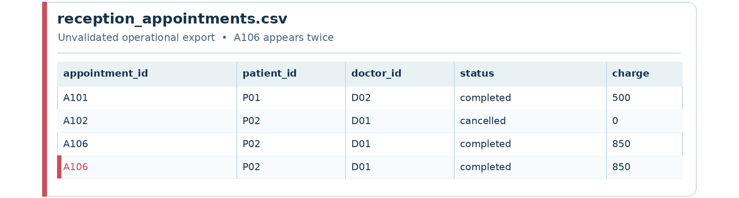
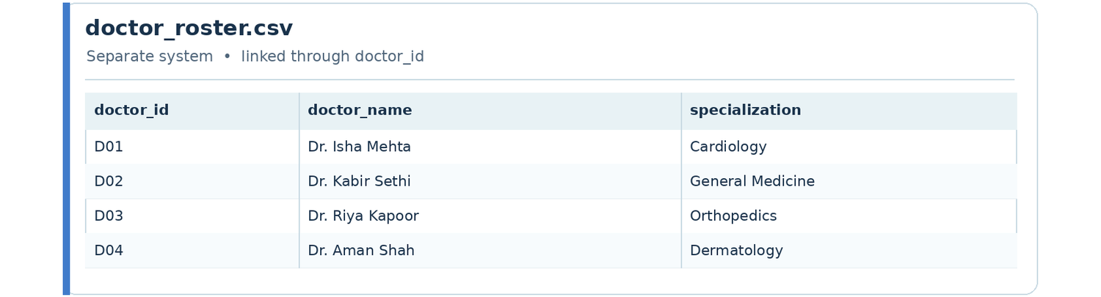
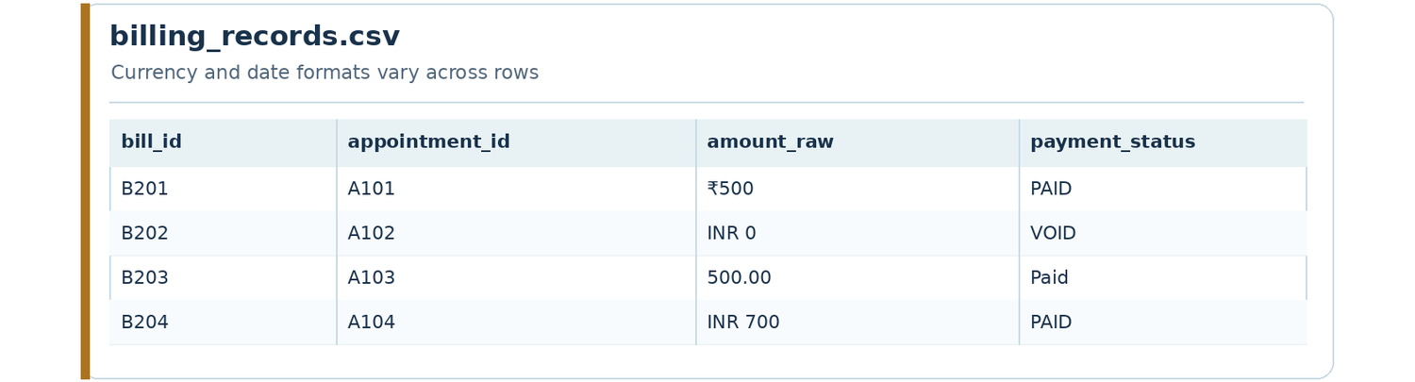
ALL ABOUT DATA ENGINEER
The messy reality behind the scenes
Three sources that look useful until we try combining them.
Reception export
Doctor roster
Billing system
A daily appointments CSV with repeated or missing IDs.
A separate list of doctors and specializations.
Charges and payment records using different formats.
Appointments CSV preview
Doctor roster preview
Billing CSV preview
TAKEAWAY
The engineer’s task is to make these sources usable together.
K. R. MANGALAM UNIVERSITY • 21 OCT 2026
NAMAN SHARMA / 21
Notes:
RUN OF SHOW — DAY 1
11:19–11:24 (5 minutes)
Session: ALL ABOUT DATA ENGINEER
Slide: The messy reality behind the scenes
FACILITATOR NOTES
Role-play a handoff from receptionist. Explain one app could export CSVs, another a database, and another an API. Ask which columns could connect these sources.
CASE DISCLAIMER
ClinicPulse Hospital and any patient/appointment data in the deck are fictional and illustrative.
IMAGE PLACEHOLDER: Suggested screenshots or diagrams: Appointments CSV preview, Doctor roster preview, Billing CSV preview. Replace editable dashed box with your own relevant image or screenshot before presenting, or leave it as a visual prompt.

Slide 22
ALL ABOUT DATA ENGINEER
ETL: three verbs to remember
Extract
Transform
Load
Read source records
Validate and reshape
Put into target store
REMEMBER
ETL defines the order of movement and processing.
K. R. MANGALAM UNIVERSITY • 21 OCT 2026
NAMAN SHARMA / 22
Notes:
RUN OF SHOW — DAY 1
11:24–11:31 (7 minutes)
Session: ALL ABOUT DATA ENGINEER
Slide: ETL: three verbs to remember
FACILITATOR NOTES
Ask students to map extract/transform/load to a daily-life analogy. Describe lookup, deduplication, casting, and writing a clean table. Source: Microsoft Azure Architecture Center.
CASE DISCLAIMER
ClinicPulse Hospital and any patient/appointment data in the deck are fictional and illustrative.

Slide 23
ALL ABOUT DATA ENGINEER
ETL vs ELT
ETL
ELT
Extract → Transform → Load
Useful when processing happens before data reaches the target.
Extract → Load → Transform
Useful when the destination warehouse/lakehouse does the processing.
THE POINT
Same objective; different place and order of transformation.
K. R. MANGALAM UNIVERSITY • 21 OCT 2026
NAMAN SHARMA / 23
Notes:
RUN OF SHOW — DAY 1
11:31–11:37 (6 minutes)
Session: ALL ABOUT DATA ENGINEER
Slide: ETL vs ELT
FACILITATOR NOTES
Be careful: one is not always superior. Explain target systems need capacity to transform for ELT; concept per Microsoft Learn.
CASE DISCLAIMER
ClinicPulse Hospital and any patient/appointment data in the deck are fictional and illustrative.

Slide 24
ALL ABOUT DATA ENGINEER
Batch vs streaming
Batch
Streaming
Process a collected set of records every hour or every night.
Example: yesterday’s completed appointments.
Process arriving events continuously or in small increments.
Example: an alert for cancellations as they happen.
THE POINT
Choose the freshness needed for the business decision.
K. R. MANGALAM UNIVERSITY • 21 OCT 2026
NAMAN SHARMA / 24
Notes:
RUN OF SHOW — DAY 1
11:37–11:44 (7 minutes)
Session: ALL ABOUT DATA ENGINEER
Slide: Batch vs streaming
FACILITATOR NOTES
Ask whether hospital annual report needs streaming; no. An urgent live dashboard could benefit. Mention complexity and cost tradeoffs.
CASE DISCLAIMER
ClinicPulse Hospital and any patient/appointment data in the deck are fictional and illustrative.

Slide 25
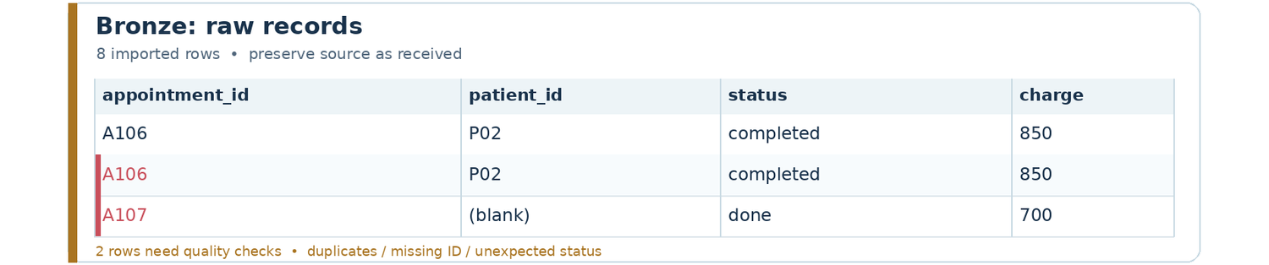
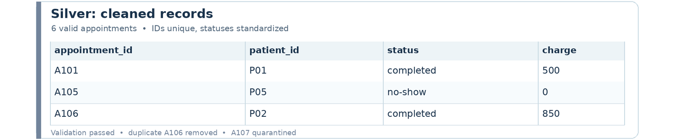
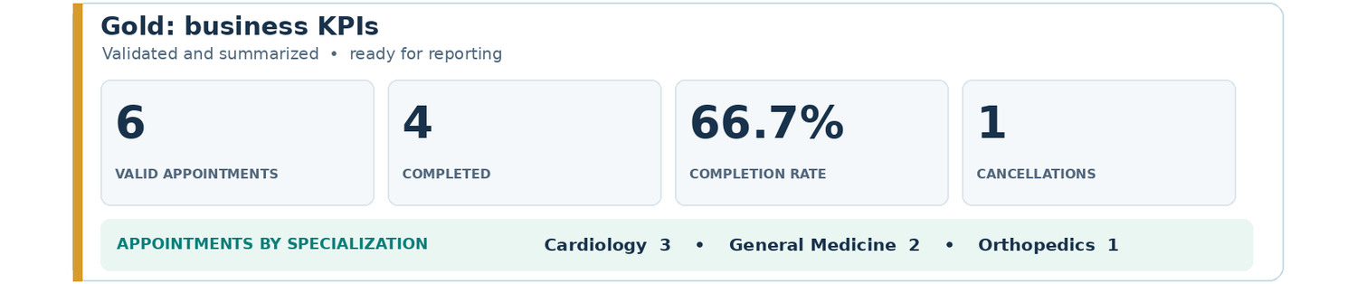
ALL ABOUT DATA ENGINEER
Bronze → Silver → Gold
BRONZE
SILVER
GOLD
Raw source snapshot
Validated, standardized
Business-ready metrics
Raw records screenshot
Clean records screenshot
KPI output screenshot
REMEMBER
Increase data quality and business usefulness at each layer.
K. R. MANGALAM UNIVERSITY • 21 OCT 2026
NAMAN SHARMA / 25
Notes:
RUN OF SHOW — DAY 1
11:44–11:52 (8 minutes)
Session: ALL ABOUT DATA ENGINEER
Slide: Bronze → Silver → Gold
FACILITATOR NOTES
Databricks medallion architecture is a logical design pattern, not a required piece of software. Explain why retaining raw records makes reprocessing possible.
CASE DISCLAIMER
ClinicPulse Hospital and any patient/appointment data in the deck are fictional and illustrative.
IMAGE PLACEHOLDER: Suggested screenshots or diagrams: Raw records screenshot, Clean records screenshot, KPI output screenshot. Replace editable dashed box with your own relevant image or screenshot before presenting, or leave it as a visual prompt.

Slide 26
ALL ABOUT DATA ENGINEER
Bronze: preserve what arrived
appointment_id
patient_id
doctor_id
status
charge
A101
P01
D02
completed
500
A102
P02
D01
cancelled
0
A106
P02
D01
completed
850
A106
P02
D01
completed
850
A107
(blank)
D03
done
700
LOOK CLOSER
Duplicates, blanks and inconsistent statuses should be detected—not hidden.
K. R. MANGALAM UNIVERSITY • 21 OCT 2026
NAMAN SHARMA / 26
Notes:
RUN OF SHOW — DAY 1
11:52–11:58 (6 minutes)
Session: ALL ABOUT DATA ENGINEER
Slide: Bronze: preserve what arrived
FACILITATOR NOTES
All records on this slide are fictional/synthetic for teaching. Ask students to find three problems; A106 duplicate, missing patient ID, non-standard done status.
CASE DISCLAIMER
ClinicPulse Hospital and any patient/appointment data in the deck are fictional and illustrative.

Slide 27
ALL ABOUT DATA ENGINEER
Silver: write three validation rules
TASK
DATA QUALITY
appointment_id should not be missing or duplicated.
What should happen to invalid rows—fix, quarantine, or discard?
patient_id and doctor_id should identify known records.
status must match an agreed list of valid values.
K. R. MANGALAM UNIVERSITY • 21 OCT 2026
NAMAN SHARMA / 27
Notes:
RUN OF SHOW — DAY 1
11:58–12:06 (8 minutes)
Session: ALL ABOUT DATA ENGINEER
Slide: Silver: write three validation rules
FACILITATOR NOTES
Spend 3 minutes individual, 3 discussion, 2 summarizing. Mention auditable handling of invalid records instead of always dropping them.
CASE DISCLAIMER
ClinicPulse Hospital and any patient/appointment data in the deck are fictional and illustrative.

Slide 28
ALL ABOUT DATA ENGINEER
Gold: create business-ready numbers
Total appointments
Completion rate
Doctor workload
Count distinct valid appointment IDs.
Completed appointments ÷ valid appointments × 100.
Appointments grouped by doctor or specialty.
K. R. MANGALAM UNIVERSITY • 21 OCT 2026
NAMAN SHARMA / 28
Notes:
RUN OF SHOW — DAY 1
12:06–12:12 (6 minutes)
Session: ALL ABOUT DATA ENGINEER
Slide: Gold: create business-ready numbers
FACILITATOR NOTES
Each definition requires a decision about which statuses are included. Ask students to consider cancelled appointments in denominator. No one right answer without agreed definition.
CASE DISCLAIMER
ClinicPulse Hospital and any patient/appointment data in the deck are fictional and illustrative.

Slide 29
ALL ABOUT DATA ENGINEER
Four practical quality checks
Completeness
Uniqueness
Validity
Consistency
Are required IDs, dates and statuses present?
Has the same appointment been recorded twice?
Are status values and dates allowed?
Do linked IDs and categories agree across tables?
K. R. MANGALAM UNIVERSITY • 21 OCT 2026
NAMAN SHARMA / 29
Notes:
RUN OF SHOW — DAY 1
12:12–12:18 (6 minutes)
Session: ALL ABOUT DATA ENGINEER
Slide: Four practical quality checks
FACILITATOR NOTES
Ask students to categorize the specific Bronze errors shown two slides earlier.
CASE DISCLAIMER
ClinicPulse Hospital and any patient/appointment data in the deck are fictional and illustrative.

Slide 30
ALL ABOUT DATA ENGINEER
Joins: connect related tables
patients
appointments
doctors
patient_id
patient_id + doctor_id
doctor_id
REMEMBER
A join adds useful context to a record by matching IDs.
K. R. MANGALAM UNIVERSITY • 21 OCT 2026
NAMAN SHARMA / 30
Notes:
RUN OF SHOW — DAY 1
12:18–12:26 (8 minutes)
Session: ALL ABOUT DATA ENGINEER
Slide: Joins: connect related tables
FACILITATOR NOTES
Draw left, inner and unmatched cases on board if students are ready. First introduce INNER JOIN by linking doctor_id; prevent confusion from repeated names.
CASE DISCLAIMER
ClinicPulse Hospital and any patient/appointment data in the deck are fictional and illustrative.

Slide 31
LUNCH
LUNCH BREAK
12:40–1:10 PM · We resume with the Data Engineer role.
K. R. MANGALAM UNIVERSITY • 21 OCT 2026
NAMAN SHARMA / 34
Notes:
RUN OF SHOW — DAY 1
12:45–13:45 (60 minutes)
Session: LUNCH
Slide: Lunch break
FACILITATOR NOTES
Leave this break slide projected. No instructional content.
CASE DISCLAIMER
ClinicPulse Hospital and any patient/appointment data in the deck are fictional and illustrative.

Slide 32
ALL ABOUT DATA ENGINEER
SQL JOIN: add doctor specialization
SQL / EXAMPLE
SELECT a.appointment_id,
a.status,
d.specialization
FROM appointments AS a
JOIN doctors AS d
ON a.doctor_id = d.doctor_id;
For each appointment, find its doctor and attach the specialization.
K. R. MANGALAM UNIVERSITY • 21 OCT 2026
NAMAN SHARMA / 31
Notes:
RUN OF SHOW — DAY 1
12:26–12:33 (7 minutes)
Session: ALL ABOUT DATA ENGINEER
Slide: SQL JOIN: add doctor specialization
FACILITATOR NOTES
Talk through each SQL line: SELECT columns, FROM appointment rows, JOIN doctors, ON shared key. Emphasize the aliases a and d are just short names. All table names illustrative.
CASE DISCLAIMER
ClinicPulse Hospital and any patient/appointment data in the deck are fictional and illustrative.

Slide 33
ALL ABOUT DATA ENGINEER
SQL GROUP BY: summarize the records
SQL / EXAMPLE
SELECT d.specialization,
COUNT(*) AS appointment_count
FROM appointments AS a
JOIN doctors AS d
ON a.doctor_id = d.doctor_id
GROUP BY d.specialization;
One row per specialization with a count of appointments.
K. R. MANGALAM UNIVERSITY • 21 OCT 2026
NAMAN SHARMA / 32
Notes:
RUN OF SHOW — DAY 1
12:33–12:39 (6 minutes)
Session: ALL ABOUT DATA ENGINEER
Slide: SQL GROUP BY: summarize the records
FACILITATOR NOTES
Explain raw rows vs grouped rows. Ask what GROUP BY specialty would return. Simplify COUNT(*) vs DISTINCT at this stage.
CASE DISCLAIMER
ClinicPulse Hospital and any patient/appointment data in the deck are fictional and illustrative.

Slide 34
ALL ABOUT DATA ENGINEER
Engineer checkpoint: explain your plan
TASK
TEAM CHECKPOINT
Identify the source tables and their join keys.
A correct explanation for the team earns full credit.
Describe one Bronze → Silver cleaning rule.
Write or describe one Gold-level KPI.
K. R. MANGALAM UNIVERSITY • 21 OCT 2026
NAMAN SHARMA / 33
Notes:
RUN OF SHOW — DAY 1
12:39–12:45 (6 minutes)
Session: ALL ABOUT DATA ENGINEER
Slide: Engineer checkpoint: explain your plan
FACILITATOR NOTES
4 minutes teams, 2 minute wrap. Remind 1:1 support exists and prior SQL experience is not required.
CASE DISCLAIMER
ClinicPulse Hospital and any patient/appointment data in the deck are fictional and illustrative.

Slide 35
ALL ABOUT DATA ANALYST
04
From trusted data to business insight
What happened? Why did it happen? What should we recommend?
K. R. MANGALAM UNIVERSITY • 21 OCT 2026
NAMAN SHARMA / 35
Notes:
RUN OF SHOW — DAY 1
13:45–13:48 (3 minutes)
Session: ALL ABOUT DATA ANALYST
Slide: From trusted data to business insight
FACILITATOR NOTES
Introduce the analyst as a decision partner rather than someone who only makes charts.
CASE DISCLAIMER
ClinicPulse Hospital and any patient/appointment data in the deck are fictional and illustrative.

Slide 36
ALL ABOUT DATA ANALYST
Where engineering ends and analysis begins
Engineering handoff
Analyst ownership
A clean, usable appointments dataset with known definitions.
Choose meaningful metrics, investigate patterns, and communicate findings.
THE POINT
The handoff is collaborative; analysts should still question data quality.
K. R. MANGALAM UNIVERSITY • 21 OCT 2026
NAMAN SHARMA / 36
Notes:
RUN OF SHOW — DAY 1
13:48–13:53 (5 minutes)
Session: ALL ABOUT DATA ANALYST
Slide: Where engineering ends and analysis begins
FACILITATOR NOTES
Connect to earlier session. Mention that smaller teams can combine roles.
CASE DISCLAIMER
ClinicPulse Hospital and any patient/appointment data in the deck are fictional and illustrative.

Slide 37
ALL ABOUT DATA ANALYST
Frontend processing: prepare for analysis
Inspect
Slice
Calculate
Present
Understand column meaning
Filter by date / doctor
Define measures
Chart + explanation
REMEMBER
A dashboard is only useful when the underlying metric is understood.
K. R. MANGALAM UNIVERSITY • 21 OCT 2026
NAMAN SHARMA / 37
Notes:
RUN OF SHOW — DAY 1
13:53–13:59 (6 minutes)
Session: ALL ABOUT DATA ANALYST
Slide: Frontend processing: prepare for analysis
FACILITATOR NOTES
This is user workbook terminology frontend processing: interpreted as analytic transformations and preparation in the reporting layer; not web frontend coding. Explain carefully.
CASE DISCLAIMER
ClinicPulse Hospital and any patient/appointment data in the deck are fictional and illustrative.

Slide 38
ALL ABOUT DATA ANALYST
Start with the question, not the chart
MAKE IT SPECIFIC
“Is the hospital doing well?”
is not yet a measurable question.
“What share of scheduled visits were completed this week?”
K. R. MANGALAM UNIVERSITY • 21 OCT 2026
NAMAN SHARMA / 38
Notes:
RUN OF SHOW — DAY 1
13:59–14:04 (5 minutes)
Session: ALL ABOUT DATA ANALYST
Slide: Start with the question, not the chart
FACILITATOR NOTES
Ask for one other measurable question. Explain definitions, time window, population and comparison.
CASE DISCLAIMER
ClinicPulse Hospital and any patient/appointment data in the deck are fictional and illustrative.

Slide 39
ALL ABOUT DATA ANALYST
Understand the dataset before plotting
appointment_id
doctor_id
status
date
charge
A101
D02
completed
18 Oct
500
A102
D01
cancelled
18 Oct
0
A103
D02
completed
19 Oct
500
A104
D03
completed
19 Oct
700
A105
D01
no-show
20 Oct
0
A106
D01
completed
20 Oct
850
LOOK CLOSER
Illustrative clean sample: 6 appointments, 4 completed, 1 cancelled, 1 no-show.
K. R. MANGALAM UNIVERSITY • 21 OCT 2026
NAMAN SHARMA / 39
Notes:
RUN OF SHOW — DAY 1
14:04–14:11 (7 minutes)
Session: ALL ABOUT DATA ANALYST
Slide: Understand the dataset before plotting
FACILITATOR NOTES
All data is fictional. Ask students how many appointments are in each status, how many total, and how much was collected from completed appointments (2550). Explain no-show meaning.
CASE DISCLAIMER
ClinicPulse Hospital and any patient/appointment data in the deck are fictional and illustrative.

Slide 40
ALL ABOUT DATA ANALYST
Metric definitions matter
SQL / EXAMPLE
Decision check
Completion rate =
Completed appointments
─────────────────────── × 100
All valid appointments
= 4 / 6 × 100 = 66.7%
What if cancelled visits are excluded from the denominator?
K. R. MANGALAM UNIVERSITY • 21 OCT 2026
NAMAN SHARMA / 40
Notes:
RUN OF SHOW — DAY 1
14:11–14:18 (7 minutes)
Session: ALL ABOUT DATA ANALYST
Slide: Metric definitions matter
FACILITATOR NOTES
This is mathematical pseudocode, not runnable SQL. Show completion rate 66.7% for chosen definition. With excluding cancelled, 4/5=80%; teach ambiguity and stakeholder sign-off.
CASE DISCLAIMER
ClinicPulse Hospital and any patient/appointment data in the deck are fictional and illustrative.

Slide 41
ALL ABOUT DATA ANALYST
A dashboard: one view, several decisions
CLINICPULSE / OPERATIONS OVERVIEW
Appointments
Completed
Completion rate
Cancellations
6
4
66.7%
1
APPOINTMENTS BY SPECIALIZATION
WHAT WOULD YOU DO NEXT?
Cardiology
3
Investigate cancelled visits
and review doctor demand
before changing staffing.
General Medicine
2
Orthopedics
1
K. R. MANGALAM UNIVERSITY • 21 OCT 2026
NAMAN SHARMA / 41
Notes:
RUN OF SHOW — DAY 1
14:18–14:25 (7 minutes)
Session: ALL ABOUT DATA ANALYST
Slide: A dashboard: one view, several decisions
FACILITATOR NOTES
All metrics in dashboard are based on the six synthetic records and illustrative. Talk through four KPI cards, specialization volume (D01=3, D02=2, D03=1), and implications. Distinguish observation from recommendation.
CASE DISCLAIMER
ClinicPulse Hospital and any patient/appointment data in the deck are fictional and illustrative.

Slide 42
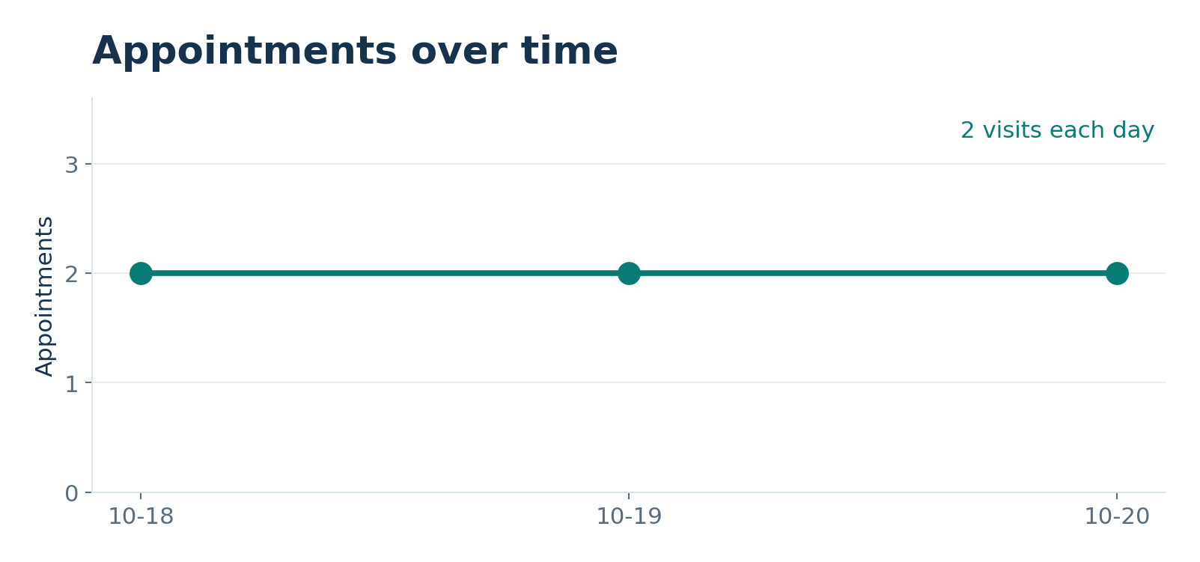
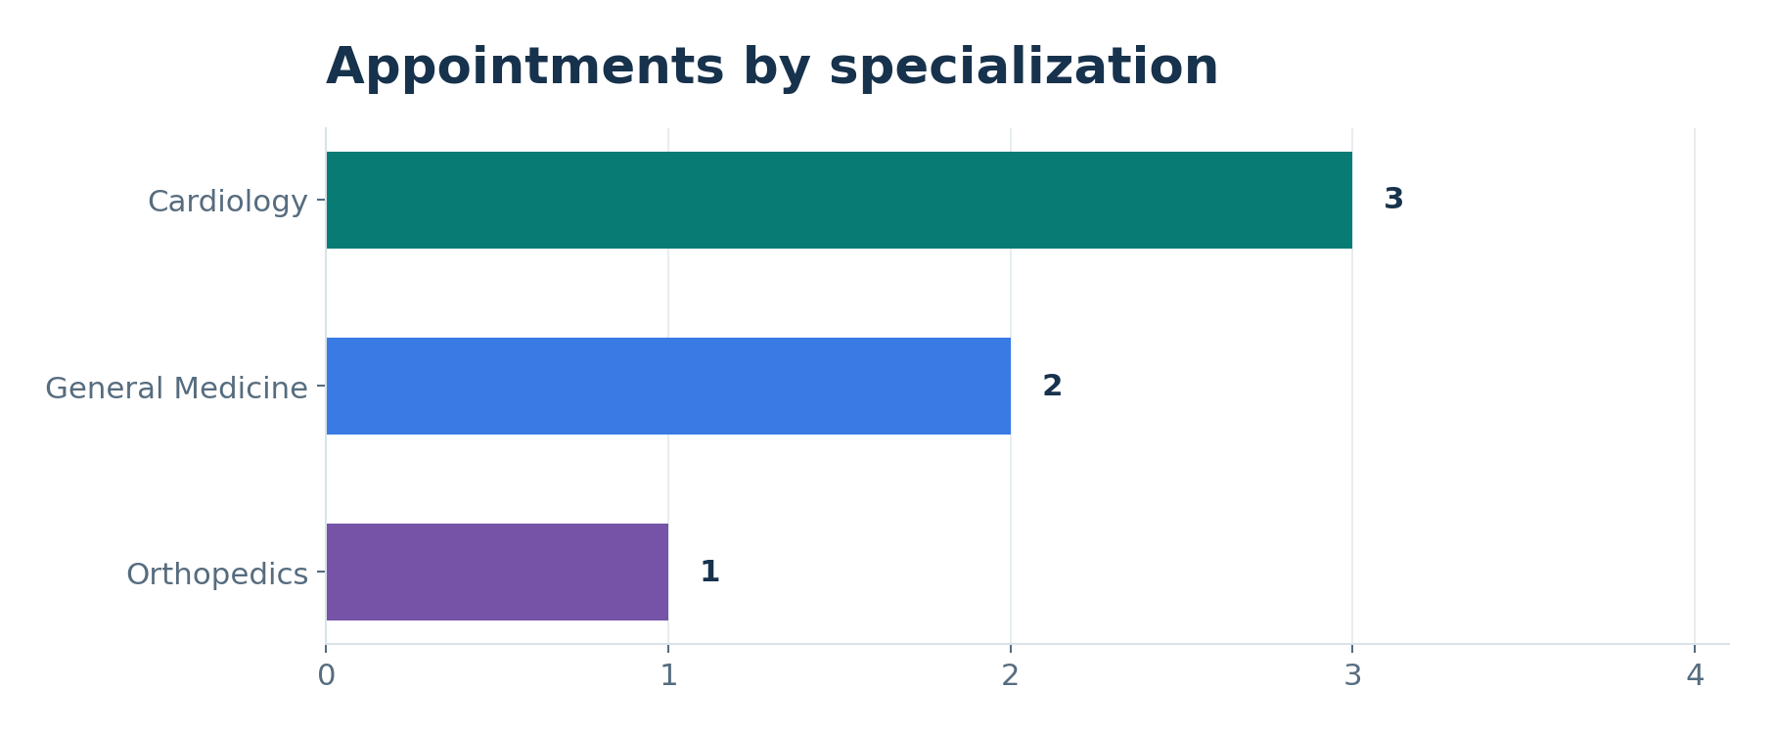
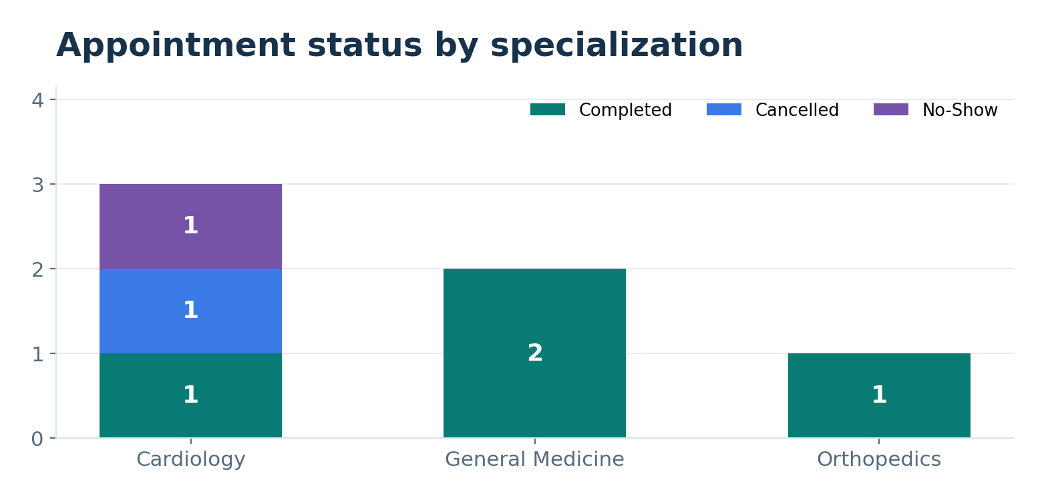
ALL ABOUT DATA ANALYST
Which chart tells the right story?
Trend over time
Compare categories
Show distribution
Line chart for daily or monthly movement.
Bar chart for doctors or specializations.
Bar or stacked bar for appointment statuses.
Line chart example
Bar chart example
Stacked bar example
K. R. MANGALAM UNIVERSITY • 21 OCT 2026
NAMAN SHARMA / 42
Notes:
RUN OF SHOW — DAY 1
14:25–14:32 (7 minutes)
Session: ALL ABOUT DATA ANALYST
Slide: Which chart tells the right story?
FACILITATOR NOTES
Ask why pie charts with many categories are difficult. Then ask students to select charts for counts vs times.
CASE DISCLAIMER
ClinicPulse Hospital and any patient/appointment data in the deck are fictional and illustrative.
IMAGE PLACEHOLDER: Suggested screenshots or diagrams: Line chart example, Bar chart example, Stacked bar example. Replace editable dashed box with your own relevant image or screenshot before presenting, or leave it as a visual prompt.

Slide 43
ALL ABOUT DATA ANALYST
Quality control before delivery
TASK
QC CHECKLIST
Do KPI cards reconcile with underlying records?
A polished incorrect dashboard is worse than a simple correct one.
Are filters, date ranges and denominators documented?
Are chart titles and labels understandable?
K. R. MANGALAM UNIVERSITY • 21 OCT 2026
NAMAN SHARMA / 43
Notes:
RUN OF SHOW — DAY 1
14:32–14:38 (6 minutes)
Session: ALL ABOUT DATA ANALYST
Slide: Quality control before delivery
FACILITATOR NOTES
Highlight analytical QC and final delivery from the workbook. Ask for typical sources of dashboard inaccuracies.
CASE DISCLAIMER
ClinicPulse Hospital and any patient/appointment data in the deck are fictional and illustrative.

Slide 44
ALL ABOUT DATA ANALYST
Turn a number into a recommendation
Observation
Action to test
Cardiology has 3 of 6 appointment records.
Review scheduling and cancellation patterns before adding staff.
THE POINT
A chart shows a pattern; a recommendation adds context and caution.
K. R. MANGALAM UNIVERSITY • 21 OCT 2026
NAMAN SHARMA / 44
Notes:
RUN OF SHOW — DAY 1
14:38–14:44 (6 minutes)
Session: ALL ABOUT DATA ANALYST
Slide: Turn a number into a recommendation
FACILITATOR NOTES
Avoid claiming demand definitively without broader history. Distinguish causation from association.
CASE DISCLAIMER
ClinicPulse Hospital and any patient/appointment data in the deck are fictional and illustrative.

Slide 45
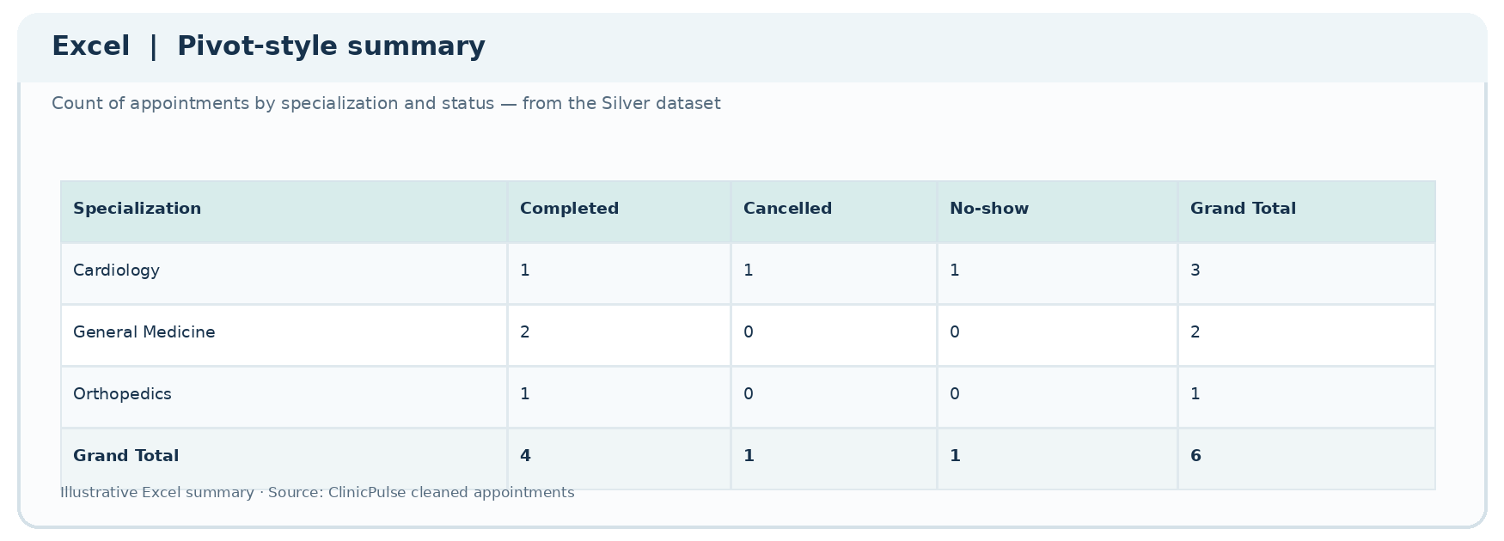
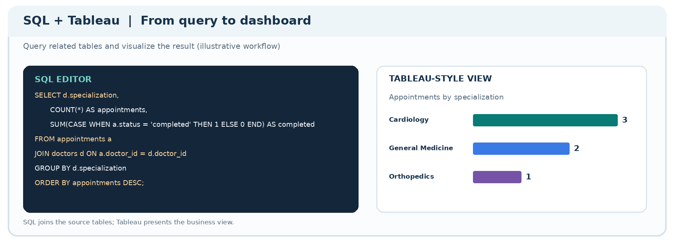
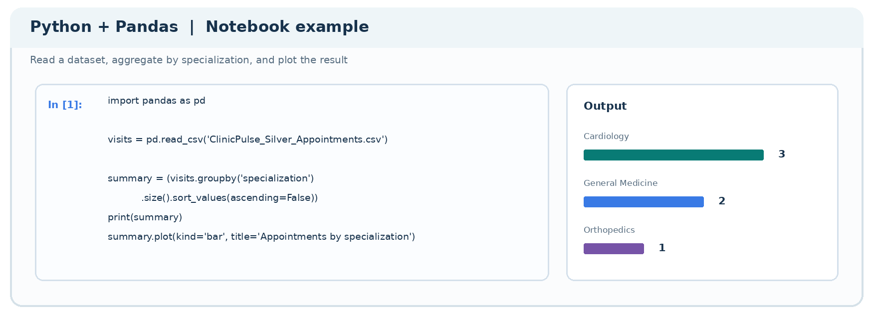
ALL ABOUT DATA ANALYST
Tools you can start with
Excel
SQL + Tableau
Python
PivotTables, lookups, quick charts and checks.
Query linked tables and build interactive reports.
Clean, summarize and visualize through Pandas.
Excel PivotTable screenshot
Tableau + SQL example
Python notebook screenshot
K. R. MANGALAM UNIVERSITY • 21 OCT 2026
NAMAN SHARMA / 45
Notes:
RUN OF SHOW — DAY 1
14:44–14:49 (5 minutes)
Session: ALL ABOUT DATA ANALYST
Slide: Tools you can start with
FACILITATOR NOTES
All are permitted for the student hackathon. Reinforce tool freedom and that solving the problem matters more than sophisticated tech.
CASE DISCLAIMER
ClinicPulse Hospital and any patient/appointment data in the deck are fictional and illustrative.
IMAGE PLACEHOLDER: Suggested screenshots or diagrams: Excel PivotTable screenshot, Tableau + SQL example, Python notebook screenshot. Replace editable dashed box with your own relevant image or screenshot before presenting, or leave it as a visual prompt.

Slide 46
ALL ABOUT DATA ANALYST
Find the misleading conclusion
TASK
The chart shows 3 cardiology visits out of 6 total.
Think time range, denominator, doctor capacity and cancellations.
A teammate says: “Cardiology is always overloaded.”
What additional evidence would you need?
K. R. MANGALAM UNIVERSITY • 21 OCT 2026
NAMAN SHARMA / 46
Notes:
RUN OF SHOW — DAY 1
14:49–14:56 (7 minutes)
Session: ALL ABOUT DATA ANALYST
Slide: Find the misleading conclusion
FACILITATOR NOTES
2 min analysis, 3 min discussion, 2 min synthesis. Invite respectful disagreement and better questions.
CASE DISCLAIMER
ClinicPulse Hospital and any patient/appointment data in the deck are fictional and illustrative.

Slide 47
ALL ABOUT DATA ANALYST
Analyst delivery checklist
Accurate
Clear
Useful
Valid numbers
Easy to understand
Answers a decision
REMEMBER
Your final output is an explanation with evidence.
K. R. MANGALAM UNIVERSITY • 21 OCT 2026
NAMAN SHARMA / 47
Notes:
RUN OF SHOW — DAY 1
14:56–15:00 (4 minutes)
Session: ALL ABOUT DATA ANALYST
Slide: Analyst delivery checklist
FACILITATOR NOTES
Transition to the business analyst who identifies the decision in the first place.
CASE DISCLAIMER
ClinicPulse Hospital and any patient/appointment data in the deck are fictional and illustrative.

Slide 48
TEA BREAK
15-MINUTE BREAK
3:00–3:15 PM · Up next: the Business Analyst role.
K. R. MANGALAM UNIVERSITY • 21 OCT 2026
NAMAN SHARMA / 48
Notes:
RUN OF SHOW — DAY 1
15:00–15:15 (15 minutes)
Session: TEA BREAK
Slide: Tea break
FACILITATOR NOTES
No instruction during this break.
CASE DISCLAIMER
ClinicPulse Hospital and any patient/appointment data in the deck are fictional and illustrative.

Slide 49
ALL ABOUT BUSINESS ANALYST
05
Translate needs into useful solutions
The bridge between stakeholders, operations and technical teams.
K. R. MANGALAM UNIVERSITY • 21 OCT 2026
NAMAN SHARMA / 49
Notes:
RUN OF SHOW — DAY 1
15:15–15:18 (3 minutes)
Session: ALL ABOUT BUSINESS ANALYST
Slide: Translate needs into useful solutions
FACILITATOR NOTES
Business analyst introduction: not a universal job title; in this session focus on requirements, processes, communication and metrics.
CASE DISCLAIMER
ClinicPulse Hospital and any patient/appointment data in the deck are fictional and illustrative.

Slide 50
ALL ABOUT BUSINESS ANALYST
The BA connects three conversations
Business request
Technical question
“We need fewer cancelled appointments.”
Which appointment states count, and which actions are in our control?
THE POINT
Clarify the problem before promising a dashboard.
K. R. MANGALAM UNIVERSITY • 21 OCT 2026
NAMAN SHARMA / 50
Notes:
RUN OF SHOW — DAY 1
15:18–15:24 (6 minutes)
Session: ALL ABOUT BUSINESS ANALYST
Slide: The BA connects three conversations
FACILITATOR NOTES
Explain stakeholders often ask for a solution rather than a precise problem; BA reframes and scopes.
CASE DISCLAIMER
ClinicPulse Hospital and any patient/appointment data in the deck are fictional and illustrative.

Slide 51
ALL ABOUT BUSINESS ANALYST
Discover requirements before building
Who?
What?
How will we know?
Who is asking, using, and approving this dashboard?
What decision must the dashboard support?
What are the exact definitions and acceptance criteria?
K. R. MANGALAM UNIVERSITY • 21 OCT 2026
NAMAN SHARMA / 51
Notes:
RUN OF SHOW — DAY 1
15:24–15:31 (7 minutes)
Session: ALL ABOUT BUSINESS ANALYST
Slide: Discover requirements before building
FACILITATOR NOTES
Roleplay as hospital manager. Ask each table group to propose one clarifying question. Separate stakeholder needs from technical functionality.
CASE DISCLAIMER
ClinicPulse Hospital and any patient/appointment data in the deck are fictional and illustrative.

Slide 52
ALL ABOUT BUSINESS ANALYST
From vague request to clear requirement
Vague request
Better requirement
Make a dashboard
Show completed, cancelled and no-show counts.
Show performance
Use a defined completion-rate formula.
Make it useful
Allow filter by date and specialization.
It should be correct
Reconcile displayed totals with validated records.
INSIGHT
A good requirement is testable and understandable.
K. R. MANGALAM UNIVERSITY • 21 OCT 2026
NAMAN SHARMA / 52
Notes:
RUN OF SHOW — DAY 1
15:31–15:38 (7 minutes)
Session: ALL ABOUT BUSINESS ANALYST
Slide: From vague request to clear requirement
FACILITATOR NOTES
Briefly explain acceptance criteria: as a manager I can filter by week and see correct totals. Demonstrate difference between requirements and design solutions.
CASE DISCLAIMER
ClinicPulse Hospital and any patient/appointment data in the deck are fictional and illustrative.

Slide 53
ALL ABOUT BUSINESS ANALYST
Define “success” precisely
CHECK THE KPI
Does “reduce cancellations” mean fewer cancellations—or a lower cancellation rate?
Define numerator, denominator, reporting period and exclusions.
K. R. MANGALAM UNIVERSITY • 21 OCT 2026
NAMAN SHARMA / 53
Notes:
RUN OF SHOW — DAY 1
15:38–15:44 (6 minutes)
Session: ALL ABOUT BUSINESS ANALYST
Slide: Define “success” precisely
FACILITATOR NOTES
Ask students to articulate two possible metrics. Tie to analyst metric ambiguity slide and engineering data validation.
CASE DISCLAIMER
ClinicPulse Hospital and any patient/appointment data in the deck are fictional and illustrative.

Slide 54
ALL ABOUT BUSINESS ANALYST
A possible BA learning path
Business basics
Excel + SQL
Requirements
Delivery
Processes and domain understanding
Simple analysis and validation
User stories, KPIs and process maps
UAT, demos, communication
K. R. MANGALAM UNIVERSITY • 21 OCT 2026
NAMAN SHARMA / 54
Notes:
RUN OF SHOW — DAY 1
15:44–15:49 (5 minutes)
Session: ALL ABOUT BUSINESS ANALYST
Slide: A possible BA learning path
FACILITATOR NOTES
This is an illustrative learning path, not guaranteed career progression. Emphasize analytical thinking and stakeholder communication.
CASE DISCLAIMER
ClinicPulse Hospital and any patient/appointment data in the deck are fictional and illustrative.

Slide 55
ALL ABOUT BUSINESS ANALYST
A BA toolkit
Analysis
Collaboration
Reporting
Excel · basic SQL · process metrics
Requirements docs · user stories · diagrams
Tableau or Power BI · presentations
K. R. MANGALAM UNIVERSITY • 21 OCT 2026
NAMAN SHARMA / 55
Notes:
RUN OF SHOW — DAY 1
15:49–15:53 (4 minutes)
Session: ALL ABOUT BUSINESS ANALYST
Slide: A BA toolkit
FACILITATOR NOTES
Keep practical: tool choice varies by employer. Call out communication and documentation as major skills.
CASE DISCLAIMER
ClinicPulse Hospital and any patient/appointment data in the deck are fictional and illustrative.

Slide 56
ALL ABOUT BUSINESS ANALYST
Role-play: The stakeholder interview
TASK
One person plays the hospital manager.
One person asks three clarifying questions.
One person writes a testable dashboard requirement.
K. R. MANGALAM UNIVERSITY • 21 OCT 2026
NAMAN SHARMA / 56
Notes:
RUN OF SHOW — DAY 1
15:53–16:00 (7 minutes)
Session: ALL ABOUT BUSINESS ANALYST
Slide: Role-play: the stakeholder interview
FACILITATOR NOTES
Encourage students to challenge vague requirements politely. End with a concrete example acceptance criterion.
CASE DISCLAIMER
ClinicPulse Hospital and any patient/appointment data in the deck are fictional and illustrative.

Slide 57
DAY 2 OVERVIEW & CLOSING
06
Tomorrow, we build it.
Today: understand the system. Tomorrow: work through it.
K. R. MANGALAM UNIVERSITY • 21 OCT 2026
NAMAN SHARMA / 57
Notes:
RUN OF SHOW — DAY 1
16:00–16:07 (7 minutes)
Session: DAY 2 OVERVIEW & CLOSING
Slide: Tomorrow, we build it.
FACILITATOR NOTES
Preview the guided Data Engineering and Analytics project. Use the previously agreed retail-sales intelligence example as a proposed implementation, not an explicit dataset in the workbook.
CASE DISCLAIMER
ClinicPulse Hospital and any patient/appointment data in the deck are fictional and illustrative.

Slide 58
DAY 2 OVERVIEW & CLOSING
What Day 2 will look like
Ingest
Clean
Analyze
Present
Open a sales dataset
Fix data issues
SQL + KPIs
Dashboard + insight
REMEMBER
You can always use Excel, SQL, Python, Tableau or a combination.
K. R. MANGALAM UNIVERSITY • 21 OCT 2026
NAMAN SHARMA / 58
Notes:
RUN OF SHOW — DAY 1
16:07–16:12 (5 minutes)
Session: DAY 2 OVERVIEW & CLOSING
Slide: What Day 2 will look like
FACILITATOR NOTES
Explain that the project is guided and a simple, correct output matters more than a polished UI.
CASE DISCLAIMER
ClinicPulse Hospital and any patient/appointment data in the deck are fictional and illustrative.
IMAGE PLACEHOLDER: Suggested screenshots or diagrams: Data sample, Clean table, SQL result, Final dashboard. Replace editable dashed box with your own relevant image or screenshot before presenting, or leave it as a visual prompt.

Slide 59
DAY 2 OVERVIEW & CLOSING
Your Day 2 checklist
Bring
Prepare
Remember
Laptop, charger, and a curious mind.
Basic spreadsheet familiarity; optional SQL revision.
Ask questions and try your own approach.
K. R. MANGALAM UNIVERSITY • 21 OCT 2026
NAMAN SHARMA / 59
Notes:
RUN OF SHOW — DAY 1
16:12–16:17 (5 minutes)
Session: DAY 2 OVERVIEW & CLOSING
Slide: Your Day 2 checklist
FACILITATOR NOTES
Keep requirements light. Explain accounts/software depend on final workshop setup. No paid API required.
CASE DISCLAIMER
ClinicPulse Hospital and any patient/appointment data in the deck are fictional and illustrative.

Slide 60
DAY 2 OVERVIEW & CLOSING
Five-question knowledge check
TASK
What does ETL stand for?
What is different about Silver vs Bronze?
Why do we join tables?
What makes a KPI trustworthy?
Who clarifies unclear business requirements?
K. R. MANGALAM UNIVERSITY • 21 OCT 2026
NAMAN SHARMA / 60
Notes:
RUN OF SHOW — DAY 1
16:17–16:23 (6 minutes)
Session: DAY 2 OVERVIEW & CLOSING
Slide: Five-question knowledge check
FACILITATOR NOTES
Rapid verbal review; allow students to answer without technical jargon. Reinforce that role responsibilities overlap.
CASE DISCLAIMER
ClinicPulse Hospital and any patient/appointment data in the deck are fictional and illustrative.

Slide 61

DAY 2 OVERVIEW & CLOSING
Resources and 1:1 follow-up
Databricks medallion architecture
https://learn.microsoft.com/en-us/azure/databricks/lakehouse/medallion
Microsoft: ETL and ELT concepts
https://learn.microsoft.com/en-us/azure/architecture/data-guide/relational-data/etl
Naman Sharma · Portfolio
https://namanofficial10.github.io/
K. R. MANGALAM UNIVERSITY • 21 OCT 2026
NAMAN SHARMA / 61
Notes:
RUN OF SHOW — DAY 1
16:23–16:27 (4 minutes)
Session: DAY 2 OVERVIEW & CLOSING
Slide: Resources and 1:1 follow-up
FACILITATOR NOTES
Clarify workshop sheet includes 4:30–6:30 PM individual support (online/offline) and an 8:45–9:15 AM offline 1:1 block. These are separate from classroom teaching.
CASE DISCLAIMER
ClinicPulse Hospital and any patient/appointment data in the deck are fictional and illustrative.

Slide 62
DAY 2 OVERVIEW & CLOSING
GOOD DATA. BETTER DECISIONS.
See you tomorrow for the hands-on project.
Naman Sharma
K. R. MANGALAM UNIVERSITY • 21 OCT 2026
NAMAN SHARMA / 62
Notes:
RUN OF SHOW — DAY 1
16:27–16:30 (3 minutes)
Session: DAY 2 OVERVIEW & CLOSING
Slide: Good data. Better decisions.
FACILITATOR NOTES
Thank the room, encourage independent thought, and invite questions. End Day 1 by 4:30 PM.
CASE DISCLAIMER
ClinicPulse Hospital and any patient/appointment data in the deck are fictional and illustrative.

